Slide 1
Queues
What do they do? Do they do useful things? Let’s find out!

Slide 2
What’s a queue
Instead of doing something in a single program on a single machine, you store a record that it should be done, stick that record in a separate system, and some other program does it later.
It’s like Kanban for computers.

Slide 3
What’s in a queue?
Redis
task
Application
task
task
task
task
task
Worker
Worker
Worker
DB
Worker
Worker
Worker

Slide 4
Break it on down
To improve that we break it up into threeish pieces:
Producer
Loops through the input list, enqueues a job to be done and the input needed to do it
Queue
Holds each job and the input the worker needs to run it.
Worker(s)
Pulls (dequeues) jobs from the queue, runs them, saves output, and tells the queue that that job is done.
DB somewhere, prolly
Notes:
State:
You can use Redis extensions to give jobs a state, so they can enter queue as pending, be marked as processing when a worker is doing its thing, then get marked completed when it’s finished.

Slide 5
Why? They let you…
Restart (instance dies at row 899,999 of 1M? No problem.)
Delay (send all the emails when the market closes)
Use resources more efficiently (different size instances for different jobs)
Scale by parallelizing (queue 1M jobs, run 100 workers, finish 100x faster)
Buffer jobs (don’t block on slow job, queue it and proceed)
Prioritize: bank transaction to the fast queue, send newsletter to slow queue)
Ensure things get done (job still in queue? Not done)
Retry things (job fails? Requeue)
Track exceptions, unrecoverable errors (job fails 10x? Mark failed, move on)
Notes:
Restart helps if either the producer or the workers crash: If you the producer crashes, just rerun it, and have it check the queue for duplicates as it does it’s job, and not queue anything already in there. It’s idempotent.
If a worker crashes, if it hasn’t finished the job, it’s still in the queue marked as ‘processing.’ When the whole queue is done if you have some jobs lying around marked as processing, you can figure out what happened and redo them. This also supports marking things as error and the like.

Slide 6
User-facing use cases
Sending email
Processing images and video
Running models
Messaging and subscriptions (pub/sub)

Slide 7
The naive non-queuing implementation
// videos_table contains a million rows
// loop through the whole damn thing
// on one machine, until you’re done
for each video in videos_table
/* Slow, memory-intensive processing job
done inline,one row at a time */
end
Notes:
You have 100,000 videos to process.
Each takes five minutes.
That’s 2,000,000 minutes
If you start on Jan 1, it’ll finish on Dec 14th

Slide 8
The Producer
for each video in videos_table
where resize_job_id is null:
job = resize_system.queue_job(
video_url = video.url,
width = video.target_width,
height = video.target_height
)
update video_table
set resize_job_id = job.id
where video_id = video.image_id
Notes:
Let’s break that naive implementation into a queued system

Slide 9
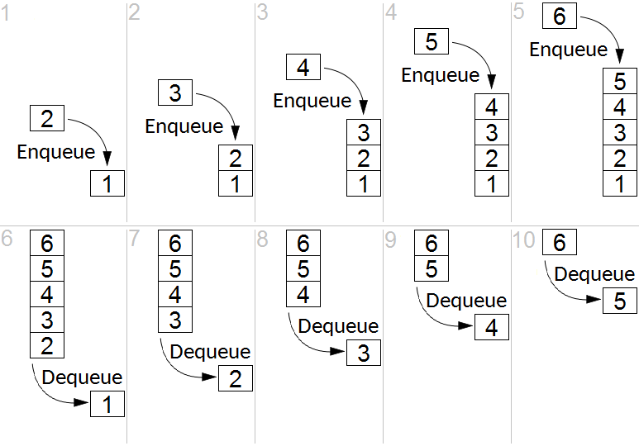
The Queue
Outside data store, most commonly FIFO. Managed Redis is good.
Thanks Wikipedia

Slide 10
Example: video processing
The input DB table contains 100,000 videos, their URLs, and the dimensions they should be resized to.
Code loops through the table, enqueues a job, and records the job_id back into the table.
Separately, you spin up a bunch of workers to burn down the queue.

Slide 11
The Workers
while true:
job = queue.dequeue() // blocks until a job is available
video = download(job.video_url)
resized_video = resize_video(
video,
width = job.target_width,
height = job.target_height
)
save(resized_video)
queue.mark_complete(job.id)
Notes:
For those 100,000 videos:
Each takes five minutes to process.
That’s 2,000,000 minutes total
You start 10,000 workers
It’s done in 50 minutes. Just enough time for a sandwich!

Slide 12
Every language supports queues
Some popular libraries:
Python: Celery
Erlang: RabbitMQ. Yes, Erlang, but a million client libraries in every language
JavaScript: BullMQ
Java: Spring Batch
Ruby: ActiveJob
Notes:
Does anyone use Spring anymore? When I was a lad, it was the bee’s knees

Slide 13
More on efficiencies
Parallelization
Different instance sizes for different job
Single thread doesn’t hold memory, jobs use what they need and disappear
Spin down to zero: have a watcher process look at the queue. If it’s empty for a while, spin everything down. When something appears in it, spin up a container to take care of it.
Conversely, if if the watcher sees the queue rapidly growing, it can spin up more and more instances to burn it down.
You can have multiple queues for the same job, and use those to prioritize: the fast queue always takes precedence, when that’s empty the slow queue gets burned down.

Slide 14
You can design correctly but working locally
Ways to design for queues without all the yucky cloud and CI/CD stuff:
You can configure Celery with task_always_eager (or ActiveJob to inline,etc) and that’s what it does–just runs it synchronously. But all the programming semantics stay the same so when you move to prod, you just change the configuration.
Although with Docker you can spin up real, albeit not very productiony, queue and worker instances local, and do it more real. Might as well reall–just ask AI.

Slide 15
Questions, discussion

